Slide 1
Security Hardening – Case Study - Switch
Layer 2 Switch STIG
DISA, Release 20
28 Oct, 2016

Slide 2
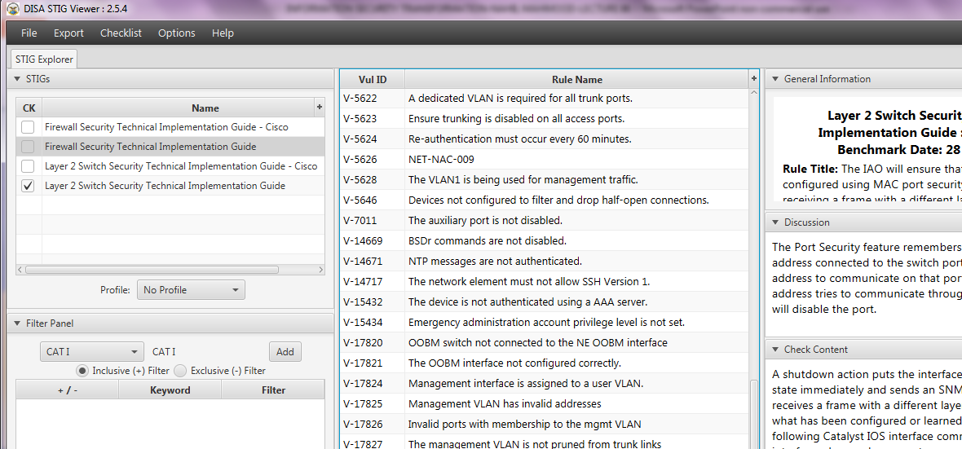
Security Hardening – Case Study - Switch
STIGVIEWER WINDOW

Slide 3
Security Hardening – Case Study - Switch
General Information:
Rule Title : The IAO to that all switchports configured using MAC port security will shutdown upon receiving a frame with a different layer 2 source address than what has been configured or learned for port security

Slide 4
Security Hardening – Case Study - Switch
General Information:
Vuln ID: V-18565
STIG ID: NET-NAC-032
Severity: CAT III

Slide 5
Security Hardening – Case Study - Switch
Discussion:
The Port Security feature remembers the Ethernet MAC address connected to the switch port and allows only that MAC address to communicate on that port…

Slide 6
Security Hardening – Case Study - Switch
…Discussion:
…If any other MAC address tries to communicate through the port, port security will disable the port.

Slide 7
Security Hardening – Case Study - Switch
Check Content:
A shutdown action puts the interface into the error-disabled state immediately and sends an SNMP trap notification if it receives a frame with a different layer 2 source address that what has been…

Slide 8
Security Hardening – Case Study - Switch
Check Content:
…configured or learned for port security. The following Catalyst IOS interface command will shutdown the interface when such an event occurs: switchport port-security violation shutdown

Slide 9
Security Hardening – Case Study - Switch
Fix Text:
Configure the port to shutdown when insecure hosts are connected to the wall jack.
END

